Slide 1
“MEMORY MANAGEMENT”
Prepared By
Prof.Abhijit H.Khadke
SUBJECT : OS (SEM-III) UNIT : V
.

Slide 2
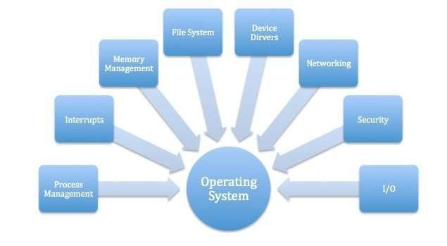
Memory Management

Slide 3
SYLLABUS :
Introduction: Memory Management concepts, Memory Management
requirements.
Memory Partitioning: Fixed Partitioning, Dynamic Partitioning, Buddy Systems Fragmentation, Paging, Segmentation, Address translation.
Placement Strategies: First Fit, Best Fit, Next Fit and Worst Fit.
Virtual Memory (VM): Concepts, Swapping, VM with Paging, Page Table Structure, Inverted Page Table, Translation Look aside Buffer, Page Size, VM with Segmentation, VM with Combined paging and
segmentation.
Page Replacement Policies: First In First Out (FIFO), Last Recently Used(LRU), Optimal, Thrashing.

Slide 4
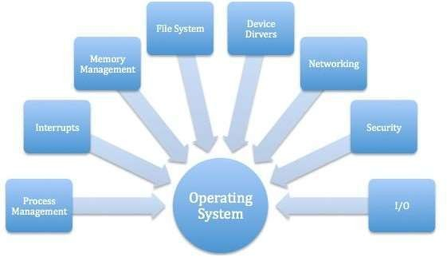
Content
Memory management:
Review of Programming Model of Intel 80386,
Contiguous and non-contiguous,
Swapping,
Paging,
Segmentation,
Segmentation with Paging.
Virtual Memory:
  Background,
  Demand paging,
  Page replacement scheme-
    FIFO,
    LRU,
    Optimal,
    Thrashing.
Case Study: Memory Management in multi-cores OS.

Slide 5

Memory management
We have seen how CPU can be shared by a set of processes
  Improve system performance
  Process management
Need to keep several process in memory
  Share memory
Learn various techniques to manage memory
  Hardware dependent

Slide 6
Memory management
What are we going to learn?
Basic Memory Management: logical vs. physical address space, protection, contiguous memory allocation, paging, segmentation, segmentation with paging.
Virtual Memory: background, demand paging, performance, page replacement, page replacement algorithms (FCFS, LRU), allocation of frames, thrashing.

Slide 7
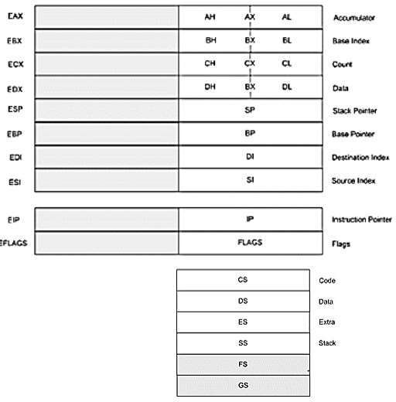
Review of Programming Model of 80386

Slide 8

Background
Program must be brought (from disk) into
memory
Fetch-decode-execute cycle
CPU
Memory unit only sees a stream of addresses + read requests, or address + data and write requests
Sequence of memory addresses generated by running program

Slide 9

Logical vs. Physical Address Space
Logical address – generated by the CPU; also
referred to as virtual address
CPU
Physical address – address seen by the memory unit
Logical address space is the set of all logical addresses generated by a program
Physical address space is the set of all physical addresses generated by a program

Slide 10
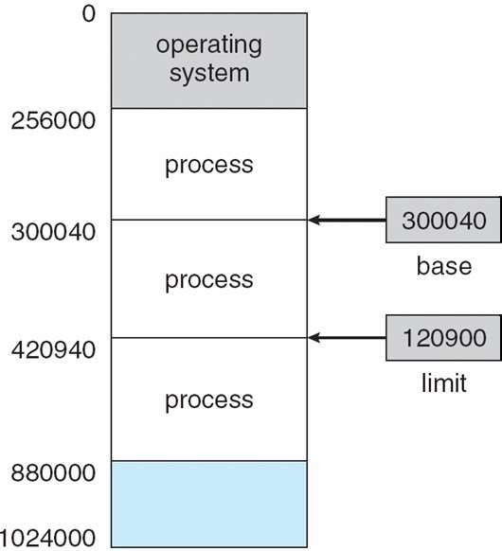
Background
Multiple processes resides in memory
Protection of memory required to ensure correct operation
Protect OS
Protect user processes

Slide 11
Base and Limit Registers
A pair of base and limit registers define the logical address space

Slide 12
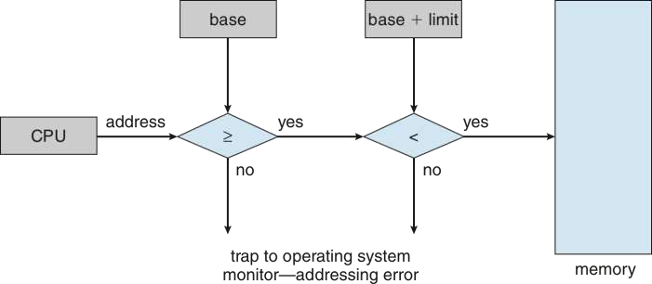
Hardware Address Protection with Base and Limit Registers
OS loads the base & limit reg.
Privileged instruction

Slide 13
Address Binding
Process resides in main memory
Associate each data element with memory address
Further, addresses represented in different ways at different stages of a program’s life
  Source code addresses usually symbolic
  Compiled code addresses bind to relocatable addresses
    i.e. “14 bytes from beginning of this module”
  Linker or loader will bind relocatable addresses to absolute addresses
    i.e. 74014

Slide 14
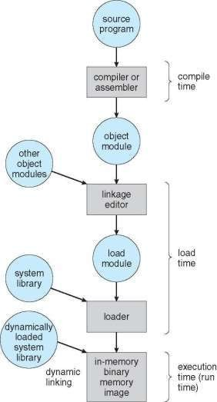
Multistep Processing of a User Program

Slide 15
Binding of Instructions and Data to Memory
Address binding of instructions and data to memory addresses can happen at three different stages
  Compile time: If memory location known a priori, absolute code can be generated; must recompile code if starting location changes
  Load time: Must generate relocatable code if memory location is not known at compile time
  Execution time: If the process can be moved during its execution from one memory segment to another
    Binding delayed until run time
    Need hardware support for address maps (e.g., base and limit
registers)

Slide 16
Logical vs. Physical Address Space
Logical address – generated by the CPU; also referred to
as virtual address
CPU
Physical address – address seen by the memory unit
Logical and physical addresses are the same in compile-time and load-time address-binding schemes;
logical (virtual) and physical addresses differ in execution-time address-binding scheme
Logical address space is the set of all logical addresses generated by a program
Physical address space is the set of all physical addresses generated by a program

Slide 17
Memory-Management Unit (MMU)
Hardware device that at run time maps virtual to physical address
Many methods possible
To start, consider simple scheme where the value in the relocation register is added to every address generated by a user process at the time it is sent to memory
  relocation register
  MS-DOS on Intel 80x86 used 4 relocation registers
The user program deals with logical addresses (0 to max); it never sees the real physical addresses (R to R+max)
  Say the logical address 25
  Execution-time binding occurs when reference is made to location
in memory
  Logical address bound to physical addresses

Slide 18
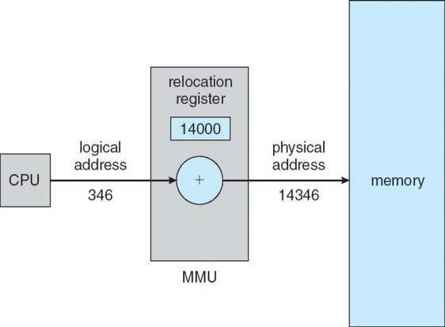
Dynamic relocation using a relocation register
14000
Relocatable code

Slide 19
Contiguous Allocation
Multiple processes resides in memory

Slide 20
Contiguous Allocation
Main memory usually divided into two partitions:
  Resident operating system, usually held in low memory
  User processes then held in high memory
  Each process contained in single contiguous section of memory

Slide 21
Contiguous Allocation (Cont.)
Multiple-partition allocation
  Divide memory into several Fixed size partition
  Each partition stores one process
  Degree of multiprogramming limited by number of partitions
  If a partition is free, load process from job queue
  MFT (IBM OS/360)

Slide 22
Contiguous Allocation (Cont.)
Multiple-partition allocation
  Variable partition scheme
  Hole – block of available memory; holes of various size are scattered throughout memory
  Keeps a table of free memory
  When a process arrives, it is allocated memory from a hole large
enough to accommodate it
  Process exiting frees its partition, adjacent free partitions combined
    Operating system maintains information about:
      allocated partitions b) free partitions (hole)
OS
OS
process 5
process 8
process 2
OS
process 5
process 2
OS
process 5
process 9
process 2
OS
process 5
process 9
process 10
process 2
Hole

Slide 23
Dynamic Storage-Allocation Problem
How to satisfy a request of size n from a list of free holes? Dynamic storage allocation problem
First-fit: Allocate the first hole that is big enough
Best-fit: Allocate the smallest hole that is big enough; must search
entire list, unless ordered by size
  Produces the smallest leftover hole
Worst-fit: Allocate the largest hole; must also search entire list
  Produces the largest leftover hole

Slide 24
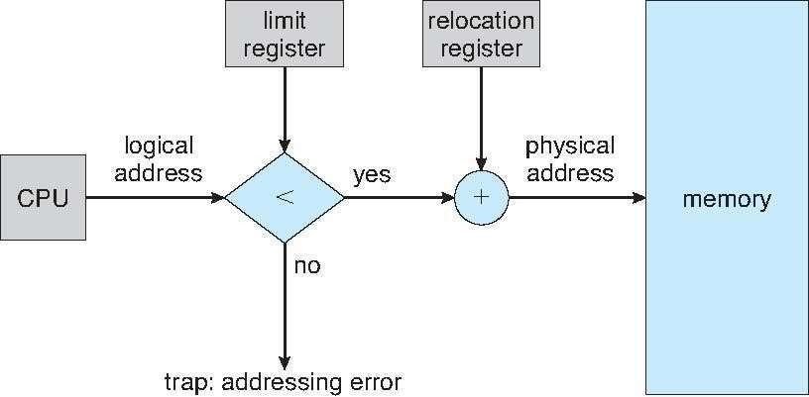
Hardware Support for Relocation and Limit Registers
Relocation registers used to protect user processes from each other, and from changing operating-system code and data
  Relocation register contains value of smallest physical address
  Limit register contains range of logical addresses – each logical address must be less
than the limit register
  Context switch
  MMU maps logical address dynamically

Slide 25
Fragmentation
Processes loaded and removed from memory
  Memory is broken into little pieces
External Fragmentation – total memory space exists to satisfy a request, but it is not contiguous
First fit analysis reveals that given N blocks allocated, 0.5 N blocks lost to fragmentation
  1/3 may be unusable -> 50-percent rule

Slide 26
Fragmentation (Cont.)
Reduce external fragmentation by compaction
  Shuffle memory contents to place all free memory together in one large block
  Compaction is possible only if relocation is dynamic, and is done at execution time
    Change relocation reg.
  Cost
Internal Fragmentation – allocated memory may be slightly larger than requested memory; this size difference is memory internal to a partition, but not being used

Slide 27
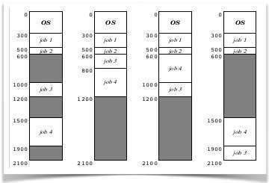

Slide 28
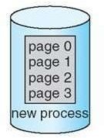
Paging
Physical address space of a process can be noncontiguous;
  process allocates physical memory whenever the latter is available
Divide physical memory into fixed-sized blocks called frames
  Size is power of 2, between 512 bytes and 16 Mbytes
Divide logical memory into blocks of same size called pages
  To run a program of size N pages, need to find N free frames and load program
Backing store likewise split into pages
Set up a page table to translate logical to physical addresses
System keeps track of all free frames

Slide 29
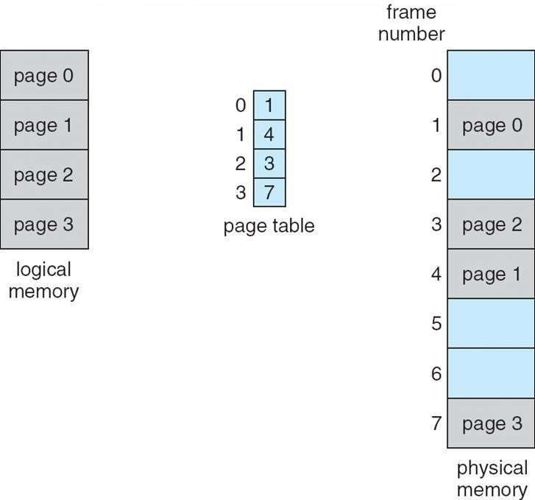
Paging Model of Logical and Physical Memory
page table to translate logical to physical
addresses

Slide 30
Address Translation Scheme
Address generated by CPU is divided into:
  Page number (p) – used as an index into a page table
    which contains base address of each page in physical memory
  Page offset (d) – offset within a page
    combined with base address to define the physical memory address that
is sent to the memory unit
offset
page
page number | page offset
p | d
^{m - n} n
– For given logical address space 2^{m} and page size 2^{n}

Slide 31
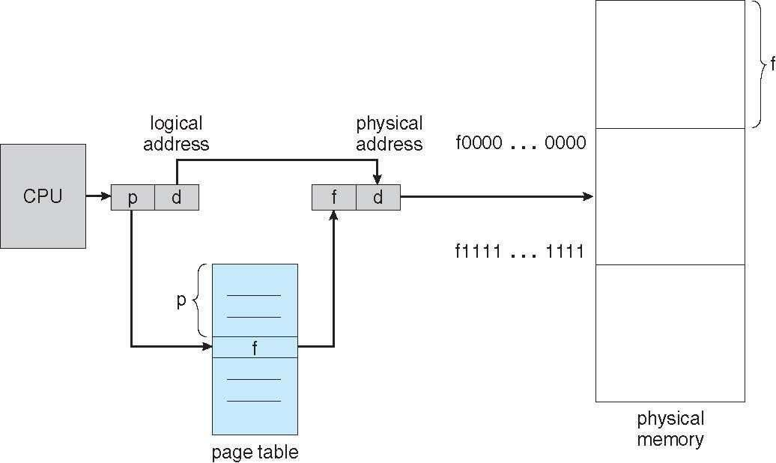
Paging Hardware

Slide 32
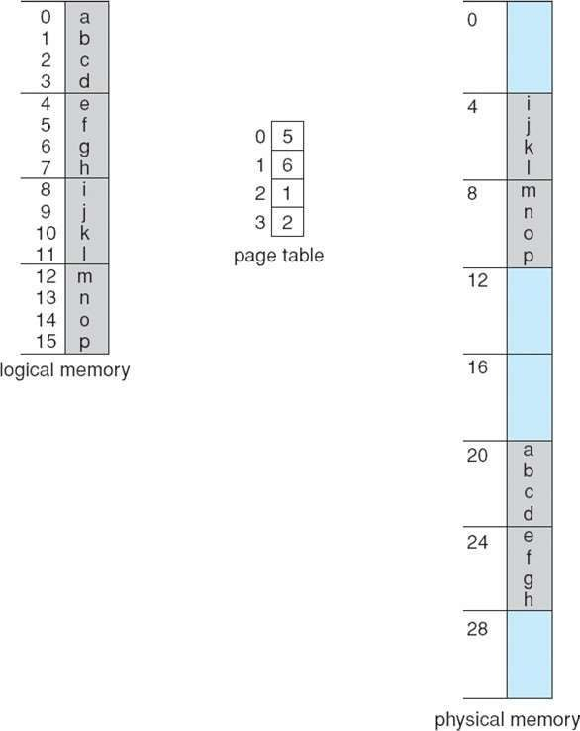
Paging Example
Logical address 0 (0*4+0)
Physical address: (5*4+0)=20
Logical address = 16 Page size=4
Physical memory=32
Logical address 3
(0*4+3)
Physical address: (5*4+0)=23
Logical address 4 (1*4+0)
Physical address: (6*4+0)=24
User’s view
Run time address binding
Logical address 13
(3*4+1)
Physical address: (2*4+1)
n=2 and m=4 32-byte memory and 4-byte pages

Slide 33
Paging
External fragmentation??
Calculating internal fragmentation
  Page size = 2,048 bytes
  Process size = 72,766 bytes
  35 pages + 1,086 bytes
  Internal fragmentation of 2,048 - 1,086 = 962 bytes
So small frame sizes desirable?
  But increases the page table size
  Poor disk I/O
  Page sizes growing over time
    Solaris supports two page sizes – 8 KB and 4 MB
User’s view and physical memory now very different
  user view=> process contains in single contiguous memory space
By implementation process can only access its own memory
– protection

Slide 34
Each page table entry 4 bytes (32 bits) long
Each entry can point to 2³² page frames
If each frame is 4 KB
The system can address 2⁴⁴ bytes (16TB) of physical memory
Virtual address space 16MB.
Page table size?

Slide 35
Process P1 arrives
Requires n pages => n frames must be available
Allocate n frames to the process P1
Create page table for P1

Slide 36
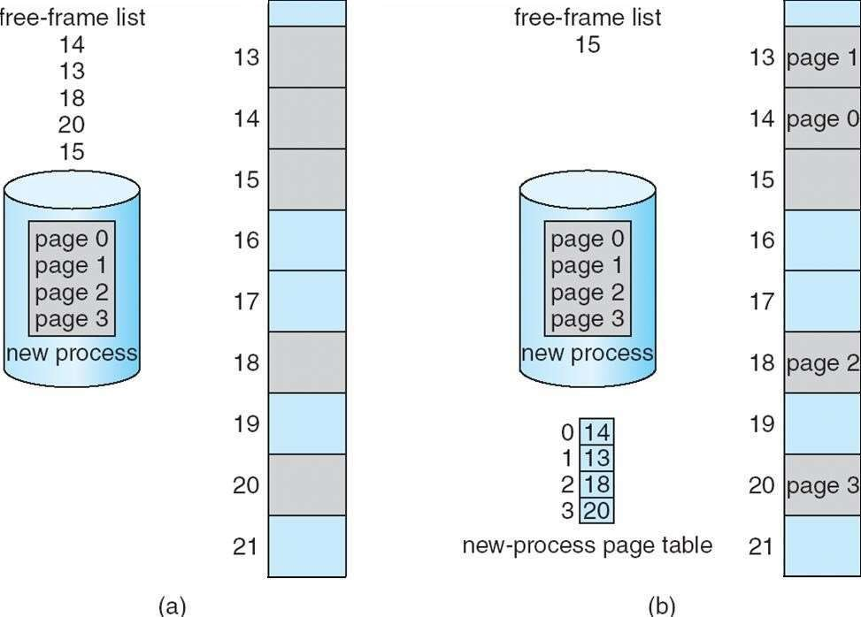
Free Frames
Frame table
Use’s view
System’s view
RAM
Before allocation
RAM
After allocation

Slide 37
Implementation of Page Table
For each process, Page table is kept in main memory
Page-table base register (PTBR) points to the page table
Page-table length register (PTLR) indicates size of the page table
In this scheme every data/instruction access requires two memory accesses
– One for the page table and one for the data / instruction
The two memory access problem can be solved by the use of a special fast-lookup hardware cache called associative memory or translation look-aside buffers (TLBs)

Slide 38
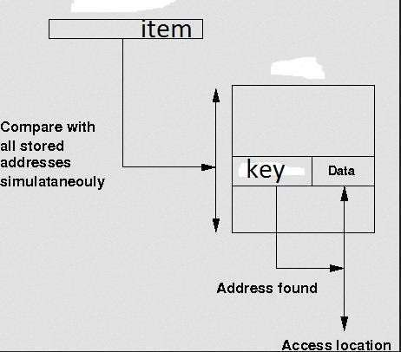
Associative memory

Slide 39
Associative Memory
Associative memory – parallel search
Page # | Frame #
Address translation (p, d)
  If p is in associative register, get frame # out
  Otherwise get frame # from page table in memory

Slide 40
Implementation of Page Table
For each process, Page table is kept in main memory
Page-table base register (PTBR) points to the page table
Page-table length register (PTLR) indicates size of the page table
In this scheme every data/instruction access requires two memory accesses
  One for the page table and one for the data / instruction
The two memory access problem can be solved by the use of a special fast-lookup hardware cache called associative memory or translation look-aside buffers (TLBs)
TLBs typically small (64 to 1,024 entries)
On a TLB miss, value is loaded into the TLB for faster access next time
  Replacement policies must be considered (LRU)
  Some entries can be wired down for permanent fast access
Some TLBs store address-space identifiers (ASIDs) in each TLB entry – uniquely
identifies each process (PID) to provide address-space protection for that process
  Otherwise need to flush at every context switch

Slide 41
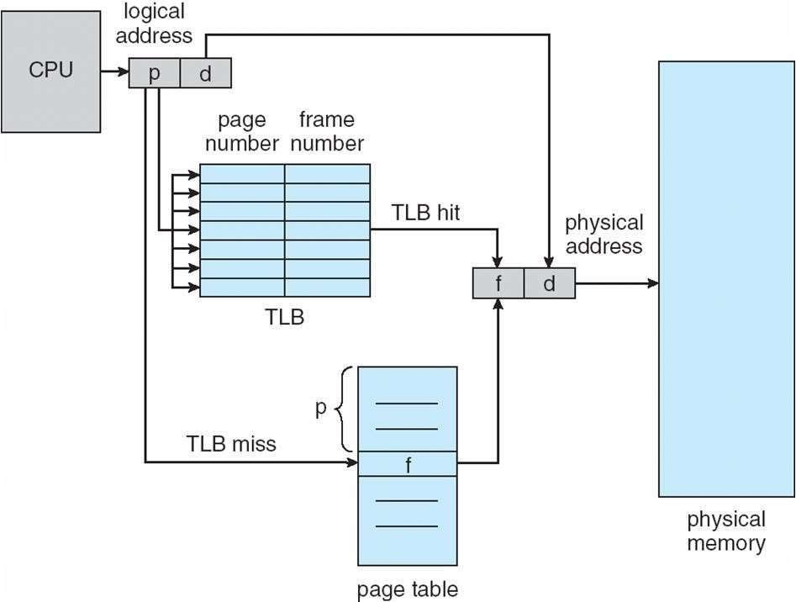
Paging Hardware With TLB

Slide 42
Effective Access Time
Associative Lookup = ε time unit
  Can be < 10% of memory access time
Hit ratio = α
  Hit ratio – percentage of times that a page number is found in the associative registers; ratio related to size of TLB
Consider α = 80%, ε = 20ns for TLB search, 100ns for memory access
Effective Access Time (EAT)
EAT = (100 + ε) α + (200 + ε)(1 – α)
Consider α = 80%, ε = 20ns for TLB search, 100ns for memory access
– EAT = 0.80 x 120 + 0.20 x 220 = 140ns
Consider better hit ratio -> α = 98%, ε = 20ns for TLB search, 100ns for
memory access
– EAT = 0.98 x 120 + 0.02 x 220 = 122ns

Slide 43
Memory Protection
Memory protection implemented by associating protection bit with each frame to indicate if read-only or read-write access is allowed
  Can also add more bits to indicate page execute-only, and so on
Valid-invalid bit attached to each entry in the page table:
  “valid” indicates that the associated page is in the process’ logical address space, and is thus a legal page
  “invalid” indicates that the page is not in the process’ logical
address space
  Or use PTLR
Any violations result in a trap to the kernel

Slide 44
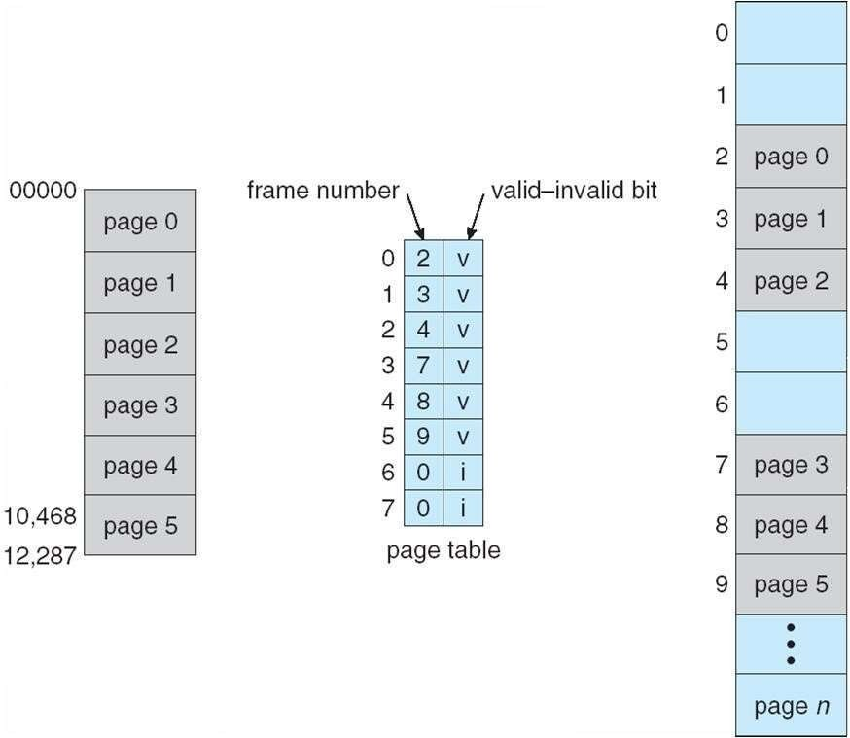
Valid (v) or Invalid (i) Bit In A Page Table
14 bit address space (0 to 16383) Page size 2KB
Process P1 uses only 0 to 10468
P2
P1
Page 0
Page 1
Page 2
Page 3
Internal fragmentation
Use of PTLR (length)

Slide 45
Shared Pages Example
System with 40 users
  Use common text editor
Text editor contains 150KB code 50KB data (page size 50KB)
– 8000KB!
Shared code
  One copy of read-only (reentrant) code shared among processes (i.e., text editors, compilers, window systems)
    Code never changes during execution
Only one copy of the editor in the memory
Total memory consumption
– 40*50+150=2150KB

Slide 46
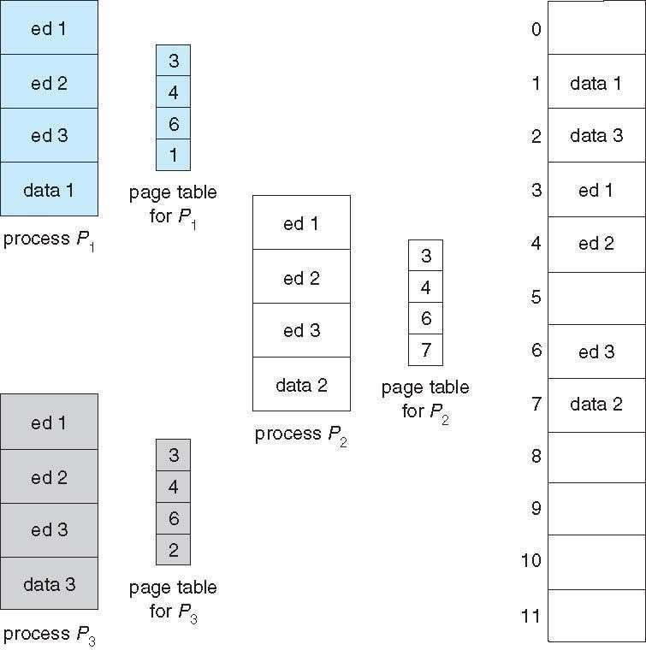
Shared Pages Example

Slide 47
Data share: example
writer.c
reader .c
int main()
{
int main()
{
int shmid,f,key=3,i,pid; char *ptr;
int shmid,f,key=3,i,pid; char *ptr;
shmid=shmget((key_t)key,100,IPC_CREAT|0666); ptr=shmat(shmid,NULL,0);
printf("shmid=%d ptr=%u\n",shmid, ptr);
strcpy(ptr,"hello");
i=shmdt((char*)ptr);
shmid=shmget((key_t)key,100,IPC_CREAT|0666); ptr=shmat(shmid,NULL,0);
printf("shmid=%d ptr=%u\n",shmid, ptr);
printf("\nstr %s\n",ptr);
}
}
ptr
Shared memory

Slide 48
Structure of the Page Table
Memory requirement for page table can get huge using straight-
forward methods
  Consider a 32-bit logical address space as on modern computers
  Page size of 4 KB (2¹²)
  Page table would have 1 million entries 2²⁰ (2³² / 2¹²)
  If each entry is 4 bytes -> 4 MB of physical address space / memory for
page table alone
    That amount of memory used to cost a lot
    Don’t want to allocate that contiguously in main memory
Hierarchical Paging
Hashed Page Tables
Inverted Page Tables

Slide 49
Hierarchical Page Tables
Break up the page table into multiple pages
We then page the page table
A simple technique is a two-level page table

Slide 50
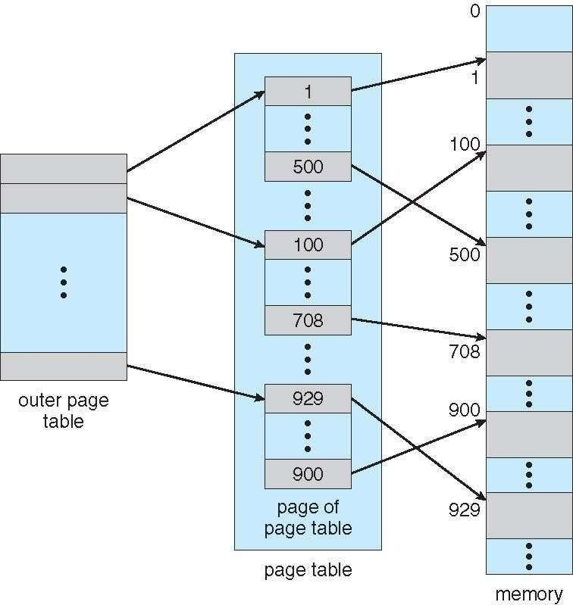
Two-Level Page-Table Scheme

Slide 51
Two-Level Paging Example
A logical address (on 32-bit machine with 4KB page size) is divided into:
  a page number consisting of 20 bits
  a page offset consisting of 12 bits
Since the page table is paged, the page number is further divided into:
  a 10-bit page number
  a 10-bit page offset
Thus, a logical address is as follows:
^{p}age number |  | page offset
p₁ | p₂ | d
¹⁰ 10 12
where p₁ is an index into the outer page table, and p₂ is the
displacement within the page of the inner page table

Slide 52
Two-Level Page-Table Scheme
Each divided page table size=2¹⁰ *4bytes=4KB
=Page size
d
p₁
p₂
Pentium II

Slide 53
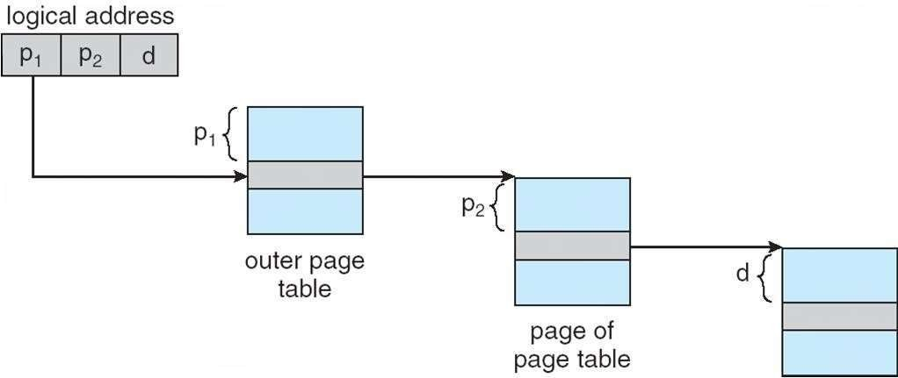
Address-Translation Scheme
Pentium II

Slide 54
64-bit Logical Address Space
Even two-level paging scheme not sufficient
If page size is 4 KB (2¹²)
  Then page table has 2⁵² entries
  If two level scheme, inner page tables could be 2¹⁰ 4-byte entries
  Address would look like
inner page
outer p
⁴² 10 12
  Outer page table has 2⁴² entries or 2⁴⁴ bytes
  One solution is to add a 2nd outer page table
  But in the following example the 2nd outer page table is still 2³⁴
bytes in size
    And possibly 4 memory access to get to one physical memory location
age |  | page offset
p₁ | p₂ | d

Slide 55
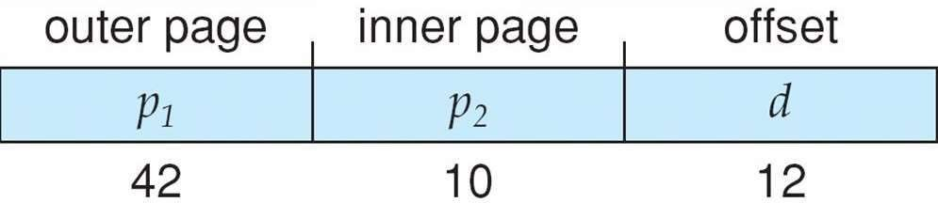
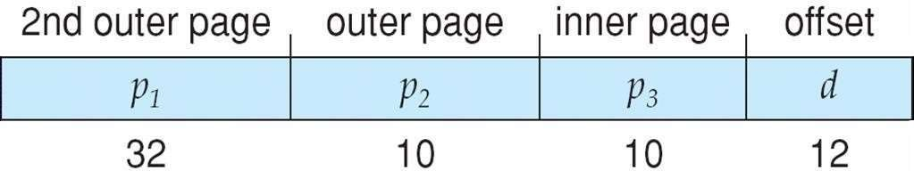
Three-level Paging Scheme
SPARC (32 bits), Motorola 68030 support three and four level paging respectively

Slide 56
Hashed Page Tables
Common in virtual address spaces > 32 bits
The page number is hashed into a page table
  This page table contains a chain of elements hashing to the same
location
Each element contains (1) the page number (2) the value of the mapped page frame (3) a pointer to the next element
Virtual page numbers are compared in this chain searching for a
match
  If a match is found, the corresponding physical frame is extracted

Slide 57
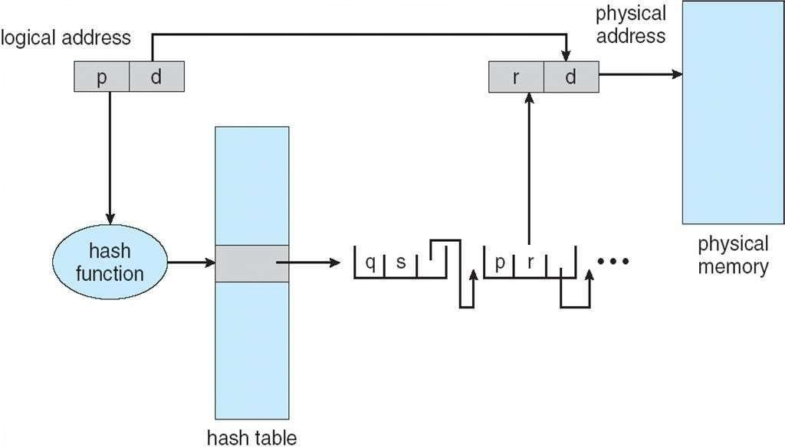
Hashed Page Table

Slide 58
Inverted Page Table
Rather than each process having a page table and keeping track of all possible logical pages, track all frames
One entry for each frame
Entry consists the page number stored in that frame, with information about the process that owns that page
Decreases memory needed to store each page table,
– but increases time needed to search the table when a page reference occurs

Slide 59
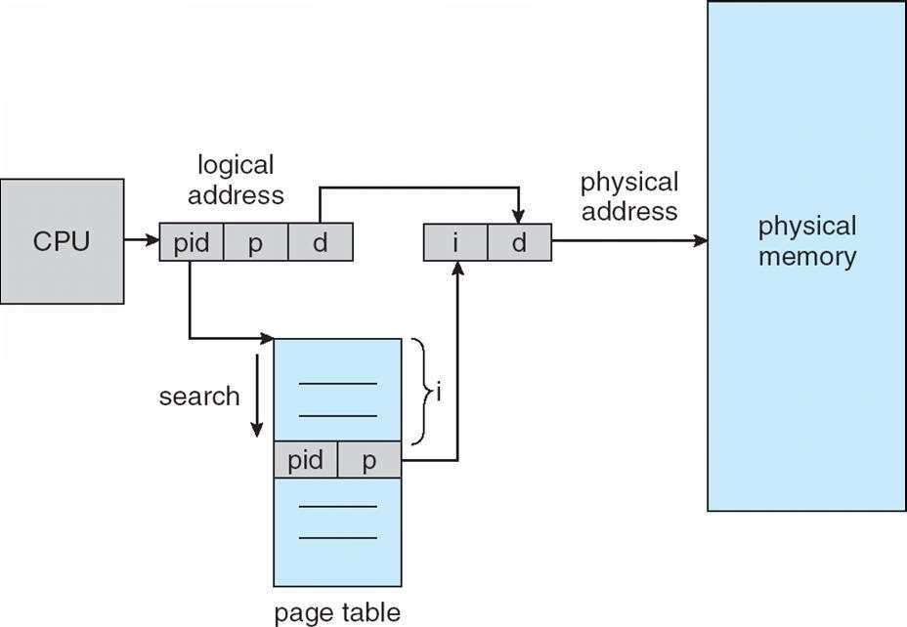
Inverted Page Table Architecture
64 bit UltraSPARC, PowerPC,
Address space ID

Slide 60
Segmentation
Memory-management scheme that supports user view of memory
A program is a collection of segments
– A segment is a logical unit such as:
Compiler generates the
main program procedure function method object
local variables, global variables
common block stack
symbol table arrays
segments
Loader assign the seg#

Slide 61
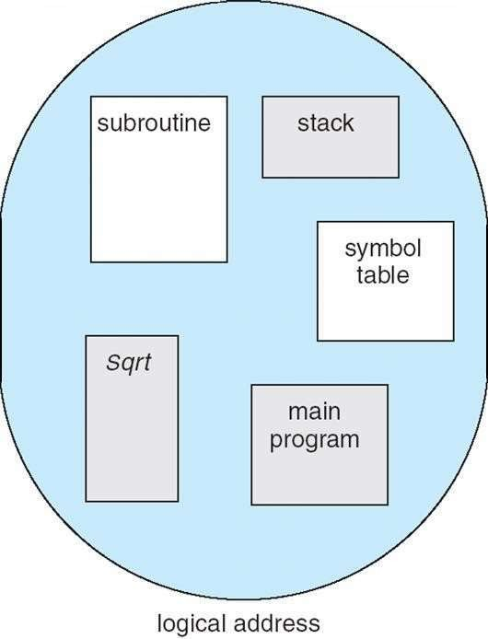
User’s View of a Program
User specifies each address
by two quantities
Segment name
Segment offset
Logical address contains the
tuple
<segment#, offset>
Variable size segments without order
Length=> purpose of the program
Elements are identified by offset

Slide 62
Logical View of Segmentation
Logical address <segment-number, offset>
1
4
2
3
1
2
3
4
Logical address space
user space physical memory space
Long term scheduler finds and allocates memory for all segments of a program
Variable size partition scheme

Slide 63
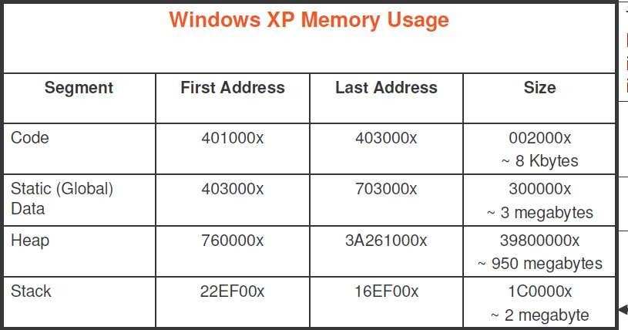

Slide 64
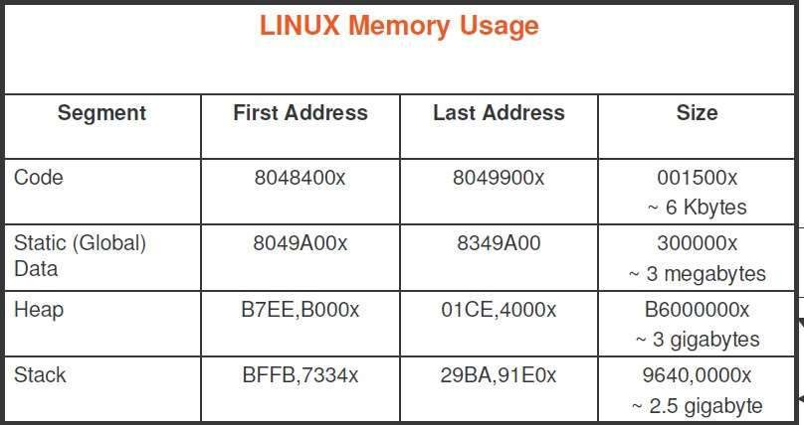

Slide 65
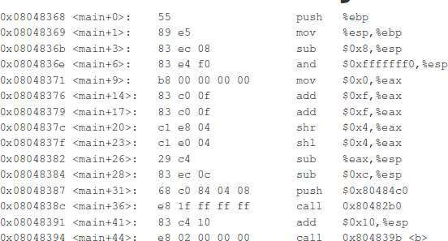
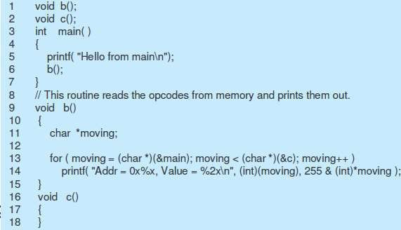
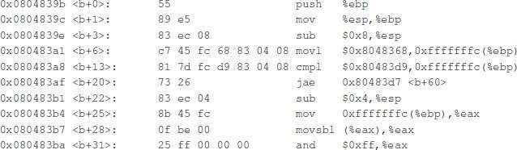
Memory image

Slide 66
Executable file and virtual address
Symbol table
Name | address
SQR | 0
SUM | 4
Virtual address space
a.out
Paging view
0
4
Load
ADD
0
4
Segmentation view
<CODE, 0>
<CODE, 2>
Load ADD
<ST,0>
<ST,4>

Slide 67
Segmentation Architecture
Logical address consists of a two tuple:
<segment-number, offset>
Segment table – maps two-dimensional logical address to physical address;
Each table entry has:
  base – contains the starting physical address where the segments reside in memory
  limit – specifies the length of the segment
Segment-table base register (STBR) points to the segment table’s location in memory
Segment-table length register (STLR) indicates number of segments used by a program;
segment number s is legal if s < STLR

Slide 68
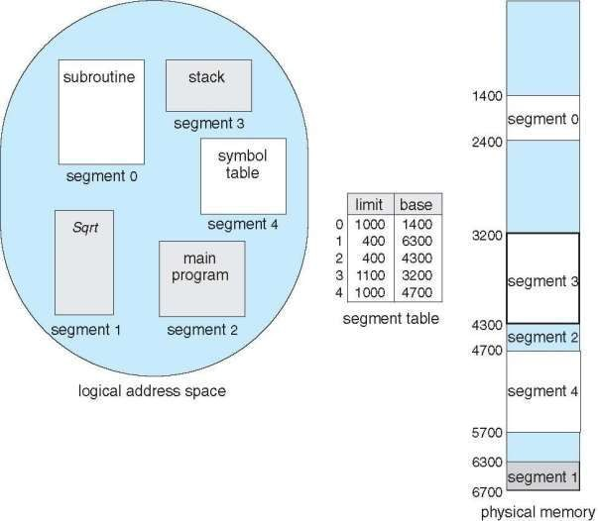
Example of Segmentation

Slide 69
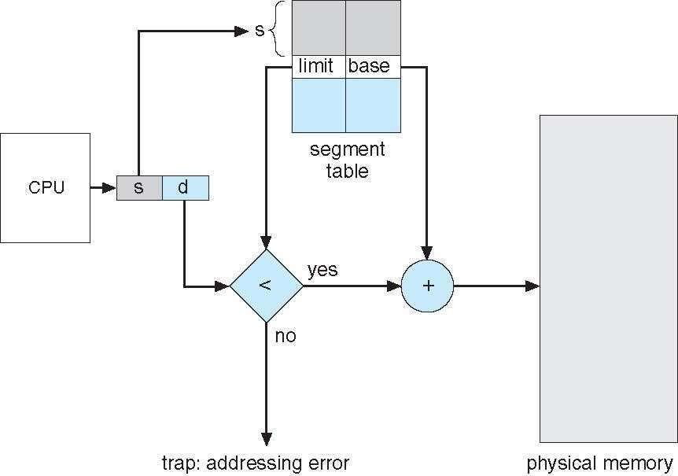
Segmentation Hardware

Slide 70
Example of Segmentation

Slide 71
Segmentation Architecture
Protection
Protection bits associated with segments
  With each entry in segment table associate:
    validation bit = 0 ⇒ illegal segment
    read/write/execute privileges
Code sharing occurs at segment level
Since segments vary in length, memory allocation is a dynamic storage-allocation problem
  Long term scheduler
  First fit, best fit etc
Fragmentation

Slide 72
Segmentation with Paging
Key idea:
Segments are splitted into multiple pages
Each page is loaded into frames in the memory

Slide 73
Segmentation with Paging
Supports segmentation with paging
  Each segment can be 4 GB
  Up to 16 K segments per process
  <selector(16), offset (32)>
  Divided into two partitions
    First partition of up to 8 K segments are private to process (kept in local descriptor table LDT)
    Second partition of up to 8K segments shared among all processes (kept in
global descriptor table GDT)
CPU generates logical address (six Segment Reg.)
  Given to segmentation unit
    Which produces linear addresses
  Physical address 32 bits
S(13) | G(1) | P(2)
– Linear address given to paging unit
Intel 80386
Which generates physical address in main memory
Paging units form equivalent of MMU
Pages sizes can be 4 KB
IBM OS/2

Slide 74
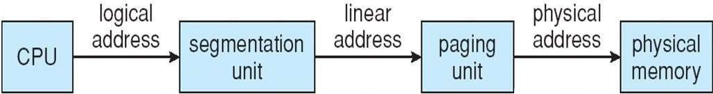
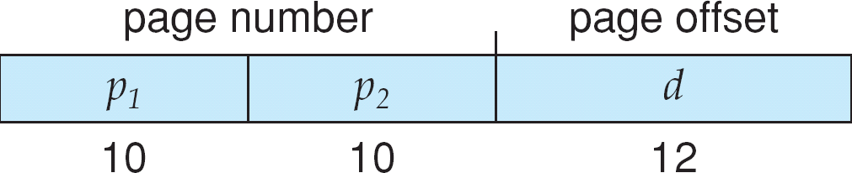
Logical to Physical Address Translation in Pentium
Page table=2²⁰ entries

Slide 75
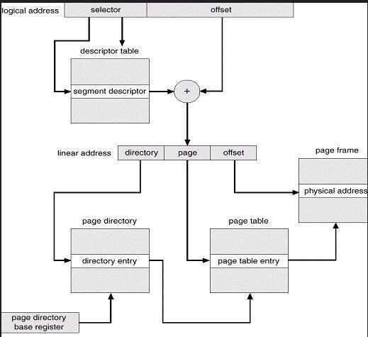
Example: The Intel Pentium
8 bytes
Segment register

Slide 76
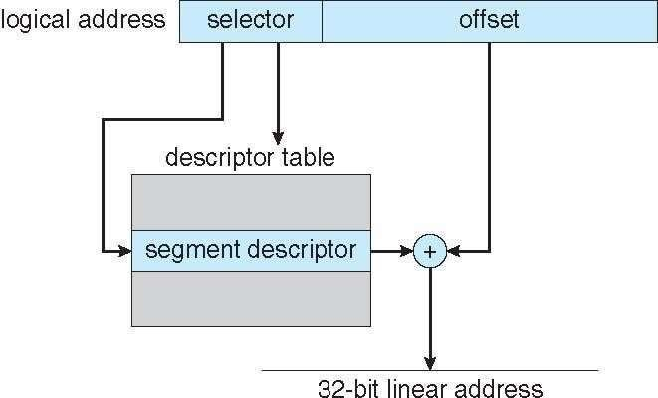
Intel Pentium Segmentation

Slide 77
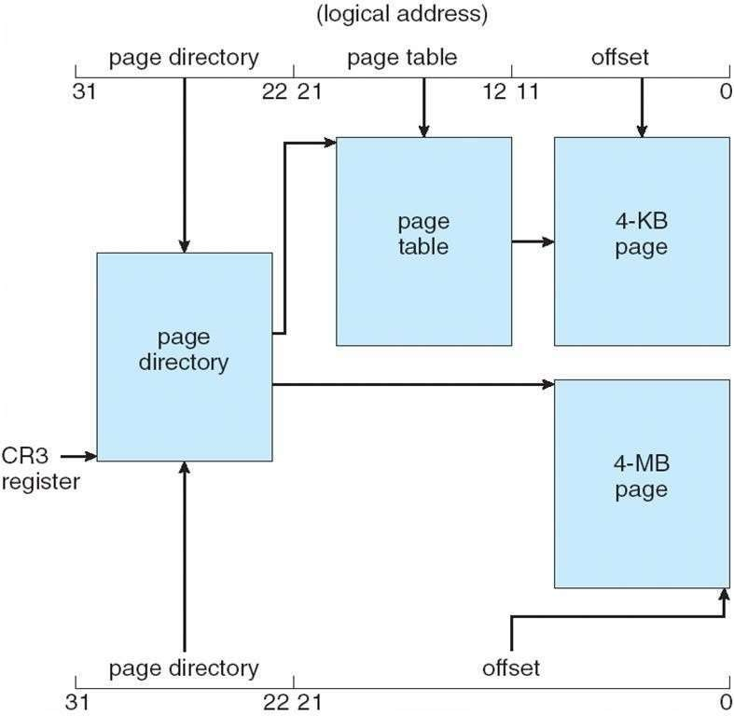
Pentium Paging Architecture

Slide 78
Virtual Memory

Slide 79
Background
Code needs to be in memory to execute, but entire program rarely used
– Error code, unusual routines, large data structures
  Entire program code not needed at same time
Consider ability to execute partially-loaded program
Program no longer constrained by limits of physical memory
programs could be larger than physical memory
More processes can be accommodated

Slide 80
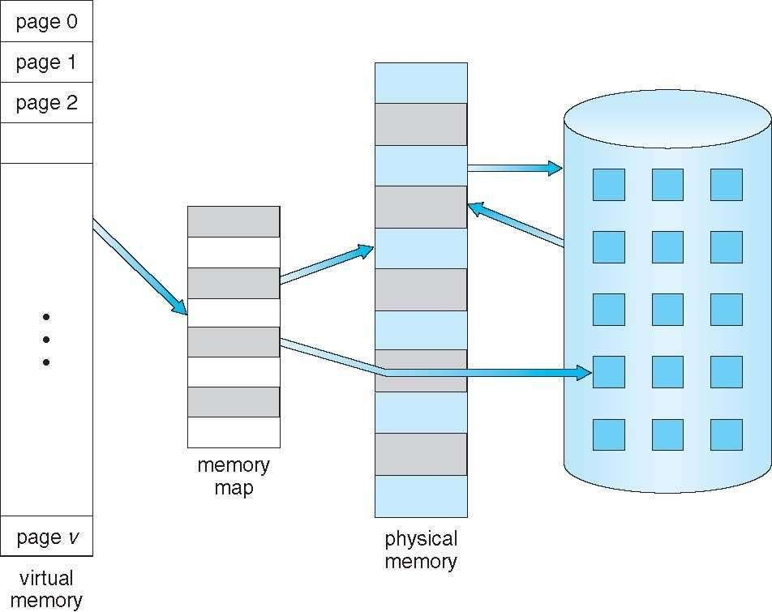
Virtual Memory That is Larger Than Physical Memory
Large virtual space
Small memory

Slide 81
Classical paging
Process P1 arrives
Requires n pages => n frames must be available
Allocate n frames to the process P1
Create page table for P1
Allocate < n frames

Slide 82
Background
Virtual memory – separation of user logical memory from physical memory
  Extremely large logical space is available to programmer
  Concentrate on the problem
Only part of the program needs to be in memory for execution
  Logical address space can therefore be much larger than physical address space
  Starts with address 0, allocates contiguous logical memory
  Physical memory
    Collection of frame
Virtual memory can be implemented via:
  Demand paging
  Demand segmentation

Slide 83
Demand Paging
Bring a page into memory only when it is needed
Lazy swapper – never swaps a page into memory unless page will be needed
  Swapper that deals with pages is a pager
Less I/O needed, no unnecessary I/O
  Less memory needed
  More users
Page is needed ⇒ reference to it
  invalid reference ⇒ abort
  not-in-memory ⇒ bring to memory
Valid address information is available in PCB

Slide 84
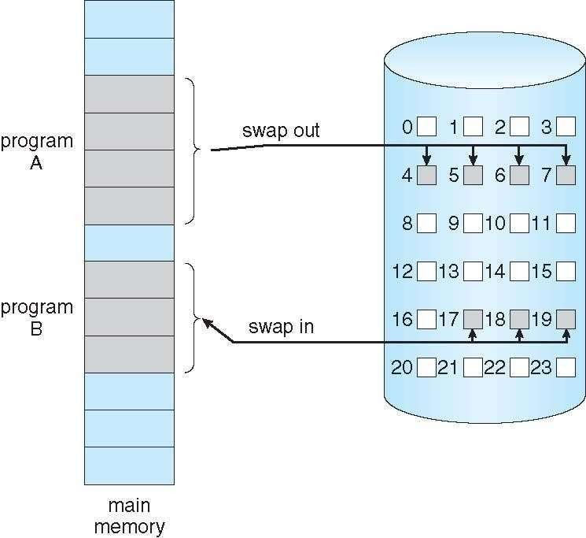
Transfer of a Paged Memory to Contiguous Disk Space
When we want to execute a process, swap in
Instead of swap in entire
process, load page
Pager

Slide 85
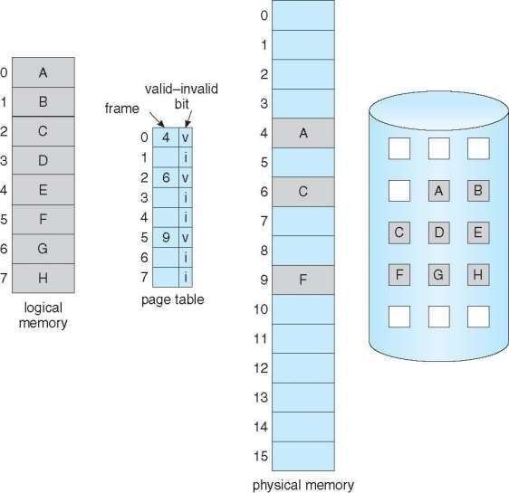
Page Table When Some Pages Are Not in Main Memory
Pager loads few necessary pages in
memory

Slide 86
Valid-Invalid Bit
With each page table entry a valid–invalid bit is associated
(v ⇒ in-memory – memory resident, i ⇒ not-in-memory)
Initially valid–invalid bit is set to i on all entries
Example of a page table snapshot:
Frame # valid-invalid bit
v v
v
v
i
page table
….
i_{i}
Disk address
During address translation, if valid–invalid bit in page table entry
is i ⇒ page fault

Slide 87
Page Fault
If the page in not in memory, first reference to that page will trap to operating system:
page fault
Operating system looks at PCB to decide:
  Invalid reference ⇒ abort
  Just not in memory (load the page)
Get empty frame
Swap page into frame via scheduled disk operation
Reset page table to indicate page now in memory
Set validation bit = v
Restart the instruction that caused the page fault

Slide 88
What Happens if There is no Free Frame?
Example
  40 frames in memory
  8 processes each needs 10 pages
  5 of them never used
Two options
  Run 4 processes (10 pages)
  Run 8 processes (5 pages)
Increase the degree of multiprogramming
– Over allocating memory
Page fault
  No free frame
  Terminate? swap out? replace the page?
Page replacement – find some page in memory, not really in use, page it out
  Performance – want an algorithm which will result in minimum number of page faults
Same page may be brought into memory several times

Slide 89
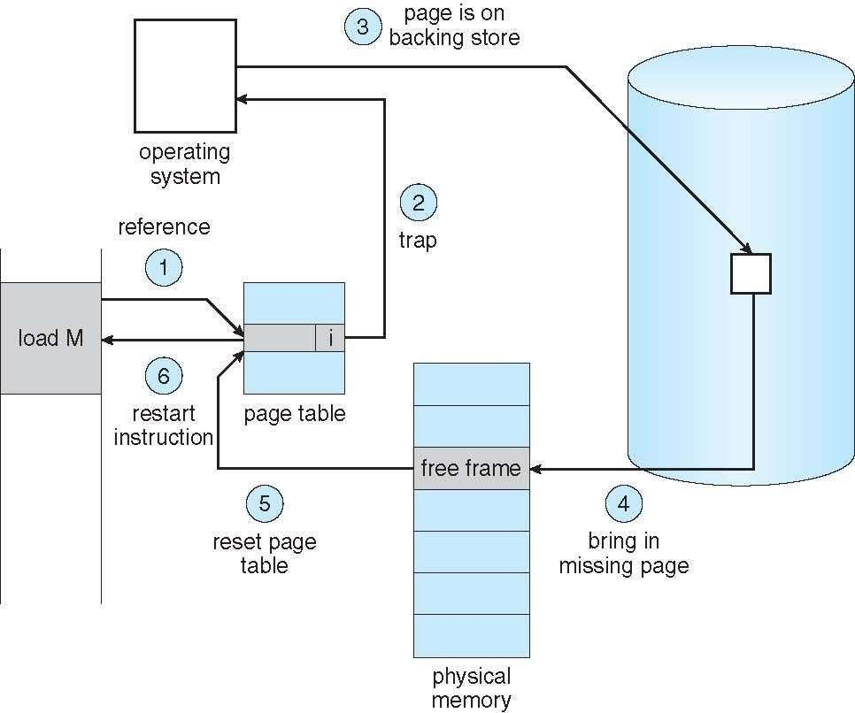
Steps in Handling a Page Fault
Check
PCB

Slide 90
Pure Demand Paging
Extreme case – start process with no pages in memory
  OS sets instruction pointer to first instruction of process, non- memory-resident -> page fault
  Swap in that page
  Pure demand paging
Actually, a given instruction could access multiple pages (instruction + data) -> multiple page faults
  Pain decreased because of locality of reference
Hardware support needed for demand paging
  Page table with valid / invalid bit
  Secondary memory (swap device with swap space)
  Instruction restart after page fault

Slide 91
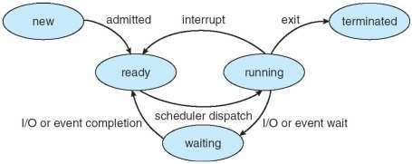
Steps in the ISR
In Demand Paging
Trap to the operating system
Save the user registers and process state
Determine that the interrupt was a page fault
Check that the page reference was legal and determine the location of the page on the disk
Get a free frame
Issue a read from the disk to a free frame:
  Wait in a queue for this device until the read request is serviced
  Wait for the device seek and/or latency time
  Begin the transfer of the page to a free frame
While waiting, allocate the CPU to some other user
Receive an interrupt from the disk I/O subsystem (I/O completed)
Save the registers and process state of the running process
Determine that the interrupt was from the disk
Correct the page table and other tables to show page is now in memory
Wait for the CPU to be allocated to this process again
Restore the user registers, process state, and new page table, and then resume the interrupted instruction

Slide 92
Performance of Demand Paging
Demand paging affects the performance of the computer systems
Page Fault Rate 0 ≤ p ≤ 1
  if p = 0 no page faults
  if p = 1, every reference is a fault
Effective Access Time (EAT)
EAT = (1 – p) x memory access
+ p (page fault overhead
+ swap page out
+ swap page in
+ restart overhead
)

Slide 93
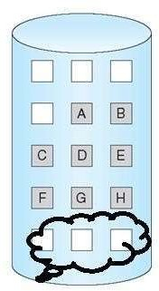

Demand Paging Example
Memory access time = 200 nanoseconds
Average page-fault service time = 8 milliseconds
EAT = (1 – p) x 200 + p (8 milliseconds)
= (1 – p ) x 200 + p x 8,000,000
= 200 + p x 7,999,800
If one access out of 1,000 causes a page fault, then EAT = 8.2 microseconds.
This is a slowdown by a factor of 40!!
If want performance degradation < 10 percent
– 220 > 200 + 7,999,800 x p
20 > 7,999,800 x p
– p < .0000025
– < one page fault in every 400,000 memory accesses
Better utilization of swap space
Swap space

Slide 94
Allocation of Frames
How do we allocate the fixed amount of memory among various processes?
Single user system
– Trivial

Slide 95
Allocation of Frames
Each process needs minimum number of frames
Minimum number is defined by the instruction set
Page fault forces to restart the instruction
  Enough frames to hold all the pages for that instruction
Example:
  Single address instruction (2 frames)
  Two address instruction (3 frames)
Maximum of course is total frames in the system
Two major allocation schemes
  fixed allocation
  proportional allocation

Slide 96
Fixed and proportional Allocation
Equal allocation – m frames and n processes
  Each process gets m/n
For example, if there are 100 frames (after allocating frames for the OS) and 5 processes, give each process 20 frames
  Keep some as free frame buffer pool
Unfair for small and large sized processes
Proportional allocation – Allocate according to the size of process
  Dynamic as degree of multiprogramming, process sizes
change
s_{i} = size of process p_{i}
S = ∑ s_{i}
m = total number of frames
m = 64
s1 = 10
s₂ = 127
_{a =} 10
× 64 ≈ 5
1
137
s
i
a = allocation for p = × m
a = ¹²⁷ × 64 ≈ 59
i i
S
2
137

Slide 97
Priority Allocation
Allocation of frames
Depends on multiprogramming level
Use a proportional allocation scheme using priorities along with size

Slide 98
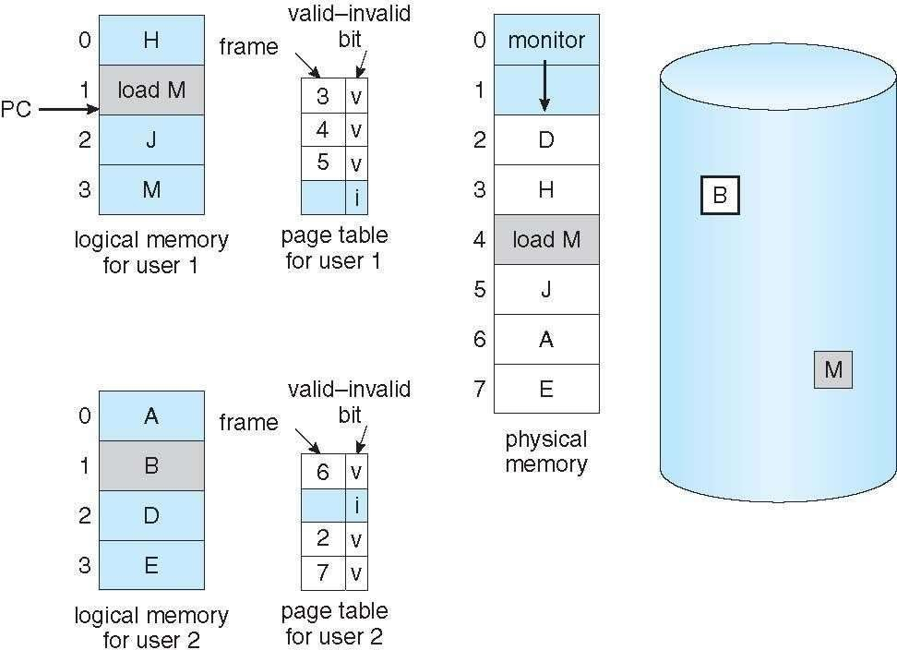
Need For Page Replacement
P1
K
P2

Slide 99
Need For Page Replacement
P1
K
P2
PC

Slide 100
Basic Page Replacement
Find the location of the desired page on disk
Find a free frame:
- If there is a free frame, use it
- If there is no free frame, use a page replacement algorithm to select a victim frame (of that process)
- Write victim frame to disk
Bring the desired page into the (newly) free frame; update the page and frame tables
Continue the process by restarting the instruction that caused the trap
Note now potentially 2 page transfers for page fault – increasing Effective memory access time

Slide 101
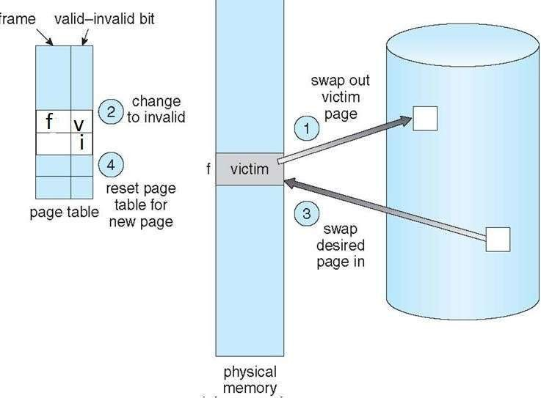
Page Replacement
5
6
5
6

Slide 102
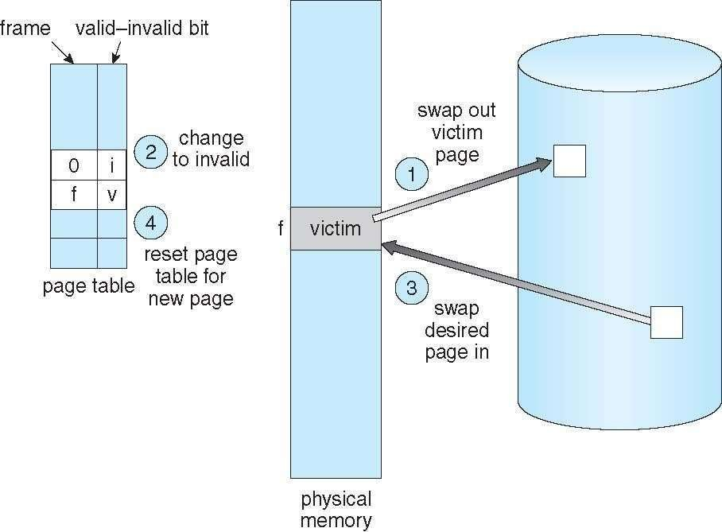
Page Replacement
5
6
5
6

Slide 103
Evaluation
Evaluate algorithm by running it on a particular string of memory references (reference string) and computing the number of page faults on that string
  String is just page numbers, not full addresses
  Repeated access to the same page does not cause a page fault
Trace the memory reference of a process
0100, 0432, 0101, 0612, 0102, 0104, 0101, 0611, 0102
Page size 100B
Reference string 1, 4, 1, 6, 1, 6
In all our examples, the reference string is
7,0,1,2,0,3,0,4,2,3,0,3,0,3,2,1,2,0,1,7,0,1

Slide 104
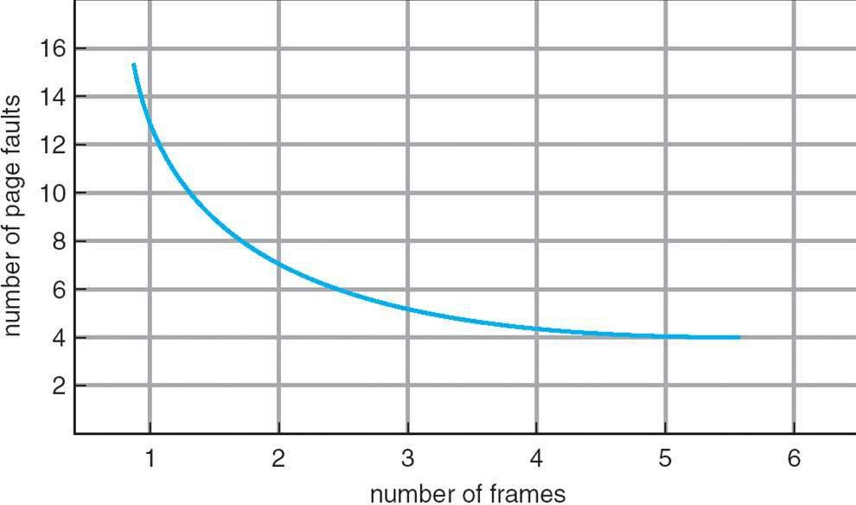
Graph of Page Faults Versus The Number of Frames

Slide 105
First-In-First-Out (FIFO) Algorithm
Associates a time with each frame when the page was brought
into memory
When a page must be replaced, the oldest one is chosen
Reference string: 7,0,1,2,0,3,0,4,2,3,0,3,0,3,2,1,2,0,1,7,0,1
Limitation:
A variable is initialized early and constantly used

Slide 106
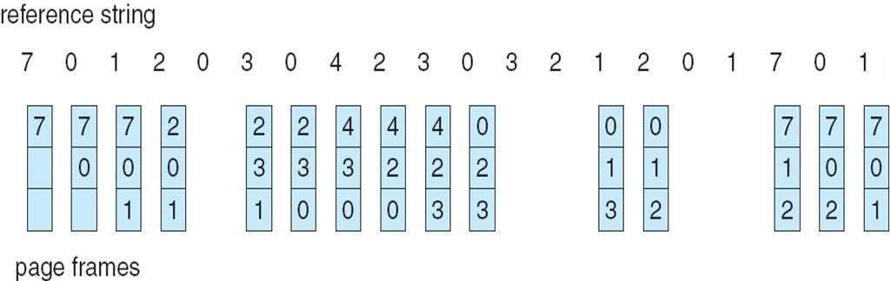
FIFO Page Replacement
3 frames (3 pages can be in memory at a time)
15 page faults
How to track ages of pages?
  Just use a FIFO queue to hold all the pages in memory
  Replace the page at the head
  Insert at tail

Slide 107
Optimal Algorithm
Replace page that will not be used for longest period of time
How do you know this?
– Can’t read the future
Used for measuring how well your algorithm performs

Slide 108
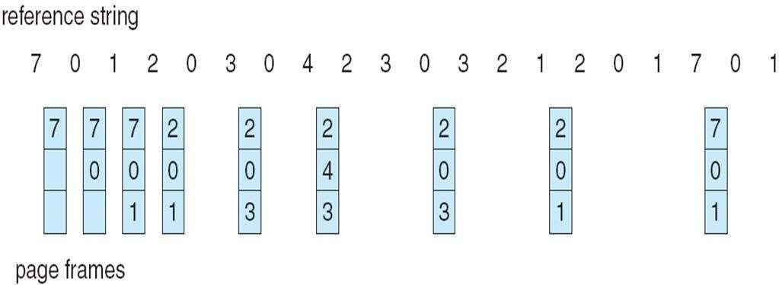
Optimal Page Replacement
9 page faults

Slide 109
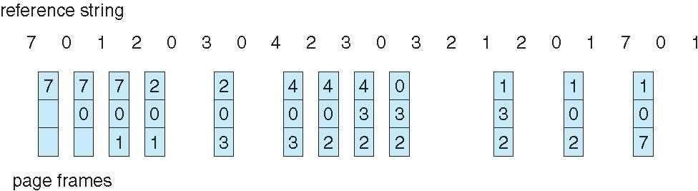
Least Recently Used (LRU) Algorithm
Use past knowledge rather than future
– Past is the proxy of future
Replace page that has not been used in the most of the
time
Associate time of last use with each page
12 faults – better than FIFO but worse than OPT
Generally good algorithm and frequently used
But how to implement?

Slide 110
LRU Algorithm-Implementation
Counter implementation
  CPU maintains a clock
  Every page entry has a Time of use;
    every time page is referenced, copy the clock into the time of use
  When a page needs to be replaced, look at the “Time of use” to find smallest value
    Search through table needed
Page table
 |  | Time of Use
Clock
CPU
0
1
2
3
address

Slide 111

LRU Algorithm-Implementation
Stack implementation
  Keep a stack of page numbers in a double linked list form:
  Page referenced:
    move it to the top
  Victim page is the bottom page

Slide 112
LRU Approximation Algorithms
LRU needs special hardware and still slow
Reference bit
  With each page associate a bit, initially = 0
  When page is referenced bit set to 1
Additional reference bit algorithm
  Record the reference bits in regular interval
  Keep a 8 bit string for each page in memory
  At regular interval, timer copies the reference bit to the high order bit (MSB) of the string.
  Shift the other bits right side by one bit

Slide 113

LRU Approximation Algorithms
Reset
reference
Period
Period Period
0 1 2 3 4 5
0 1 2 3 4 5
0 1 2 3 4 5

Slide 114
LRU Approximation Algorithms
LRU needs special hardware and still slow
Reference bit
– With each page associate a bit, initially = 0
– When page is referenced bit set to 1
Additional reference bit algorithm
Second-chance algorithm
  Generally FIFO, plus hardware-provided reference bit
  Clock replacement
  If page to be replaced has
    Reference bit = 0 -> replace it
    reference bit = 1 then:
      set reference bit 0, leave page in memory (reset the time)
      replace next page, subject to same rules

Slide 115

Second-Chance (clock) Page-Replacement Algorithm
{Reference bit, Dirty bit} combination

Slide 116
Counting Algorithms
Keep a counter of the number of references that have been made to each page
Least and most frequently used
LFU Algorithm: replaces page with smallest count
MFU Algorithm: based on the argument that the page with the smallest count was probably just brought in and has yet to be used

Slide 117
Graph of Page Faults Versus The Number of Frames

Slide 118
FIFO Example –
Program - 5 pages,
Increase in page frame decreases page fault rate?
3 frames of Memory allocated
1 2 3 4 1 2 5 1 2 3 4 5
9
faults
1 | 1
 | 2
1
2
3
4
2
3
4
1
3
4
1
2
5
1
2
5
1
2
5
1
2
5
3
2
5
3
4
5
3
4
🗏 🗏 🗏 🗏 🗏 🗏 🗏
🗏 🗏

Slide 119
FIFO Example –
Program - 5 pages,
4 frames of Memory allocated
1 2 3 4 1 2 5 1 2 3 4 5
1 | 1
 | 2
1
2
3
4
2
3
4
1
3
4
1
2
5
1
2
5
1
2
5
1
2
5
3
2
5
3
4
5
3
4
10
faults
1
1
2
1
2
3
1
2
3
4
1
2
3
4
1
2
3
4
5
2
3
4
5
1
3
4
5
1
2
4
5
1
2
3
4
1
2
3
4
5
2
3
🗏 🗏 🗏 🗏
🗏 🗏 🗏 🗏 🗏 🗏

Slide 120
Belady's Anomaly
# of Page Faults
Number of Frames
cs431-cotter
118

Slide 121
Belady’s Anomaly
This most unexpected result is known as
Belady’s anomaly – for some page- replacement algorithms, the page fault rate may increase as the number of allocated frames increases
Is there a characterization of algorithms susceptible to Belady’s anomaly?

Slide 122
Stack Algorithms
Certain page replacement algorithms are more “well behaved” than others
(In the FIFO example), the problem arises because the set of pages loaded with a memory allocation of 3 frames is not necessarily also loaded with a memory allocation of 4 frames
There are a set of paging algorithms whereby the set of pages loaded with an allocation of m frames is always a subset of the set of pages loaded with an allocation of m +1 frames. This property is called the inclusion property
Algorithms that satisfy the inclusion property are not subject to Belady’s anomaly. FIFO does not satisfy the inclusion property and is not a stack algorithm

Slide 123
LRU algorithm
6 5 3
6
4
3
9
In memory
3 frames
Outside memory
3 |  | 6 |  |  | 4 |  |  | 3 |  |  | 9
5 |  | 3 |  |  | 6 |  |  | 4 |  |  | 3
6 |  | 5 |  |  | 3 |  |  | 6 |  |  | 4
 |  |  |  |  | 5 |  |  | 5 |  |  | 6
 |  |  |  |  |  |  |  |  |  |  | 5
In memory
4 frames
5
3
6

Slide 124
Global vs. Local Allocation
Frames are allocated to various processes
If process P_{i} generates a page fault
  select for replacement one of its frames
  select for replacement a frame from another process
Local replacement – each process selects from only its own set of allocated frames
  More consistent per-process performance
  But possibly underutilized memory
Global replacement – process selects a replacement frame from the set of all frames; one process can take a frame from another
  But then process execution time can vary greatly
  But greater throughput ----- so more common
Processes can not control its own page fault rate
  Depends on the paging behavior of other processes

Slide 125
Thrashing
If a process uses a set of “active pages”
  Number of allocated frames is less than that
Page-fault
  Replace some “active” page
  But quickly need replaced “active” frame back
  Quickly a page fault, again and again
  Thrashing ≡ a process is busy swapping pages in and out
OS monitors CPU utilization
– If low? Increase the degree of multiprogramming

Slide 126

Thrashing
Global page replacement
  Process enters new phase (subroutine call) execution
  Page fault
  Taking frames from other processes
    Replace “active” frames of other processes
  These processes start page fault
  These faulting processes wait on the device queue for disk
    Ready queue empty
– CPU utilization decreases
Disk
CPU scheduler increases the degree of multiprogramming
  More page faults
  Drop in CPU utilization
Page fault increases tremendously

Slide 127

Thrashing (Cont.)

Slide 128
Thrashing
Solution
  Local replacement
  One process cannot steal frames from other processes
Provide a process as many frames as needed
  Able to load all active pages
  How do we know?
  Locality model

Slide 129
Demand Paging and Thrashing
Why does demand paging work?
Locality model
  Process migrates from one locality to another
  Localities may overlap
Allocate enough frames to a process to accommodate its locality
Why does thrashing occur?
Σ size of locality > total allocated frames
  Limit effects by using local or priority page replacement

Slide 130

Locality In A Memory-Reference Pattern

Slide 131

Working-set model

Slide 132
Working-Set Model
Δ ≡ working-set window ≡ a fixed number of page references
Example: 10,000 instructions
WSS_{i} (working set of Process P_{i}) =
total number of pages referenced in the most recent Δ (varies in time)
  if Δ too small will not encompass entire locality
  if Δ too large will encompass several localities
  if Δ = ∞ ⇒ will encompass entire program
D = Σ WSS_{i} ≡ total demand frames
  Approximation of locality
if D > m ⇒ Thrashing
Policy if D > m, then suspend or swap out one of the processes

Slide 133

Page-Fault Frequency
More direct approach than WSS
Establish “acceptable” page-fault frequency (PFF) rate and use local replacement policy
  If actual rate too low, process loses frame
  If actual rate too high, process gains frame

